Slide 1
Computer Vision Based Batch-Billing System
For Supermarket Products Using YOLO
An Approach to Minimizing Checkout Times in Stores
Rusab Sarmun
10356
Fabiha Bushra
10313

Slide 2



Motivation
MOTIVATION
Challenges of Existing System
Time-consuming
Cashier’s Speed Dependency
Barcode Scanner Based
GOAL
Batch Billing
Orientation Independent
Faster

Slide 3
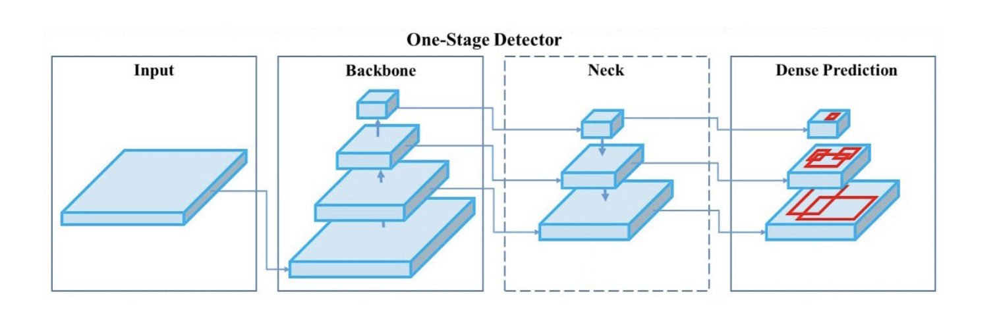
Motivation
THEORETICAL BACKGROUND
YOLOv5 ARCHITECTURE
1. Backbone
2. Neck
3. Head
CSPNet
PANet
Dense Prediction
Reference: https://www.theseus.fi/handle/10024/452552

Slide 4
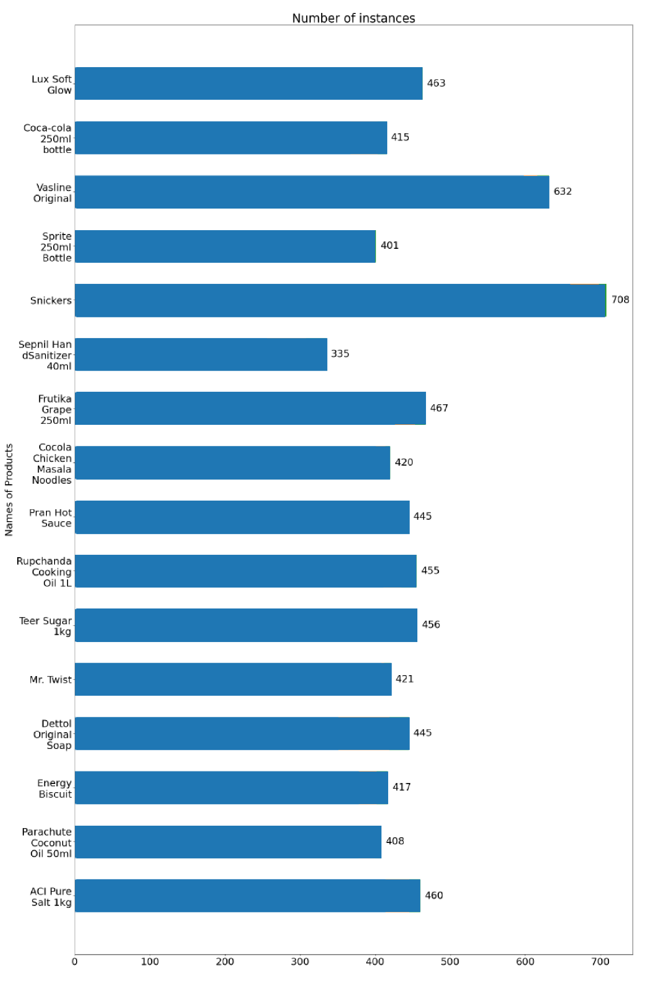
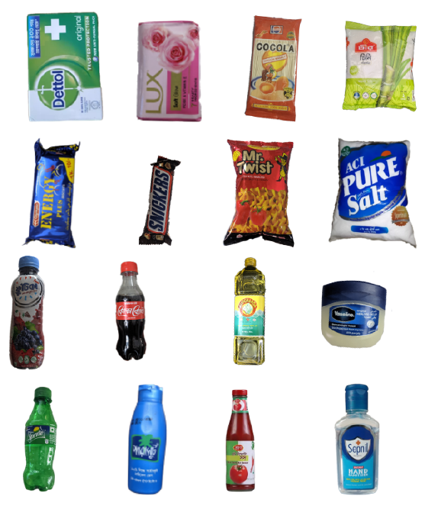



Motivation
DATASET BUILDING
Products
Images
Instances
16
3430
7438
Image Size
Annotation
416X416
Manual
ACQUISITION TECHNIQUES
Web Scraping
Phone Photography
Synthetic Images

Slide 5
Motivation
TRAINING
PRETRAINED WEIGHTS
A YOLO model was trained on COCO dataset with 300 epochs. These trained weights are used as checkpoints for our model to start training.
Our model was then trained with 100 epochs using the pre-trained weights on our dataset and saved the best weights.
TRAINING SETTINGS
Batch Size
Epochs
Optimizer
32
100
SGD

Slide 6
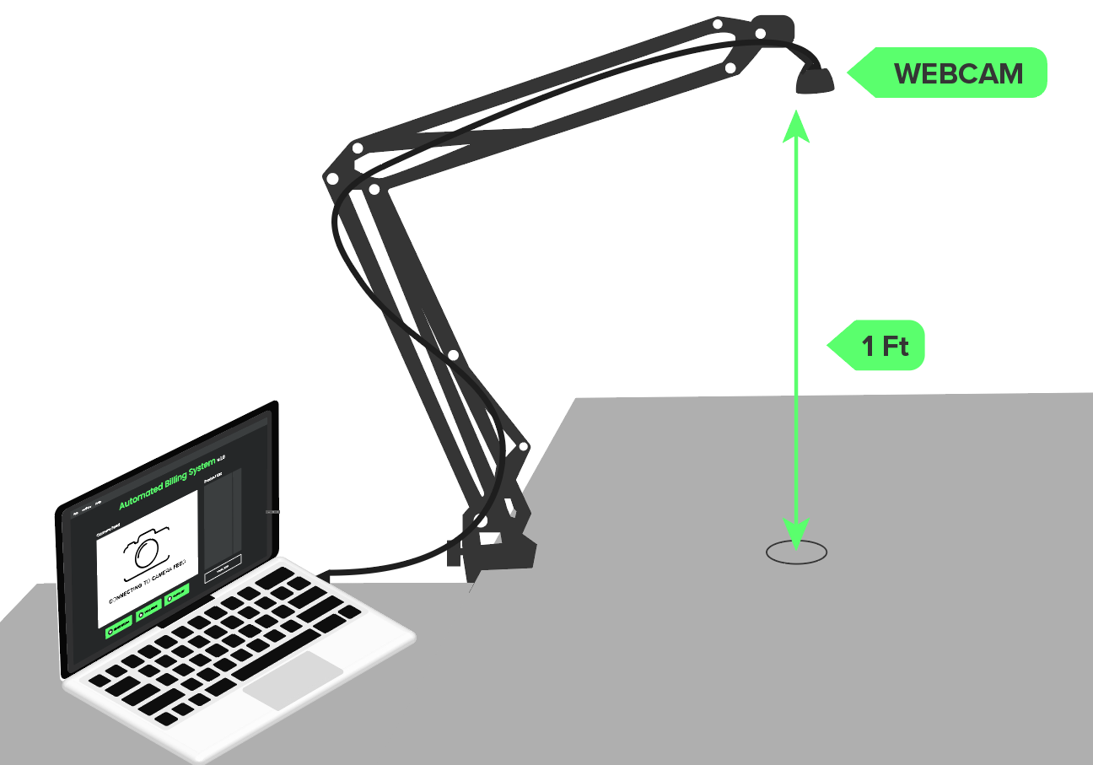
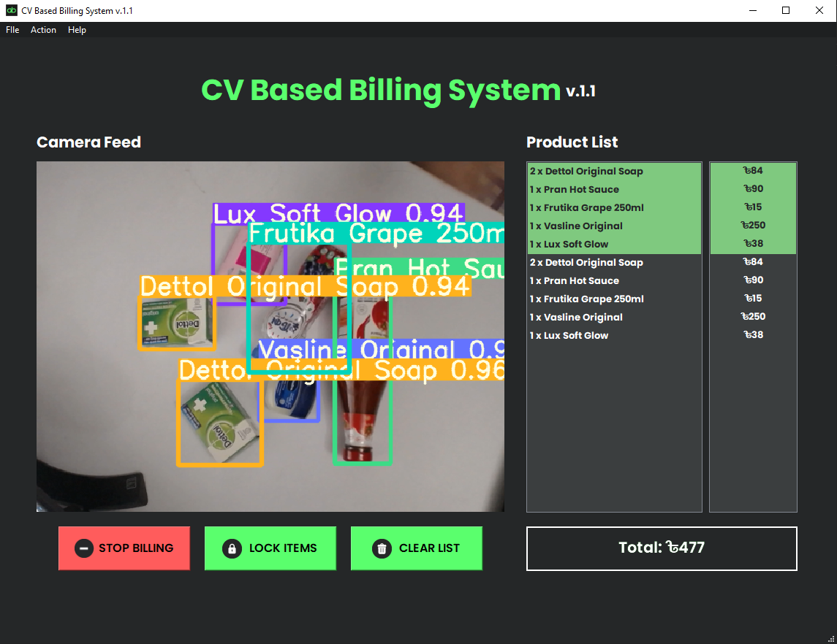
BILLING SYSTEM
HARDWARE SETUP
GUI BASED APP
Webcam (Logitech 930e)
Adjustable Arm
Computer
Product recognition
Batch Billing
Receipt Generation

Slide 7

Motivation
DEMO

Slide 8
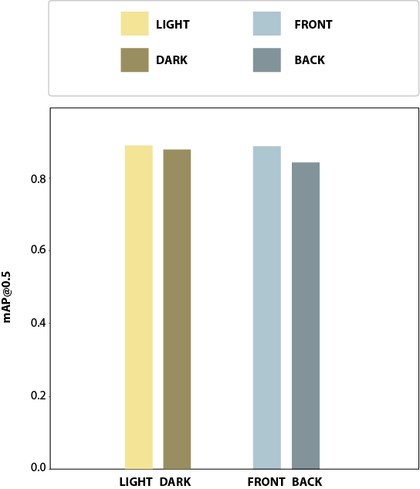
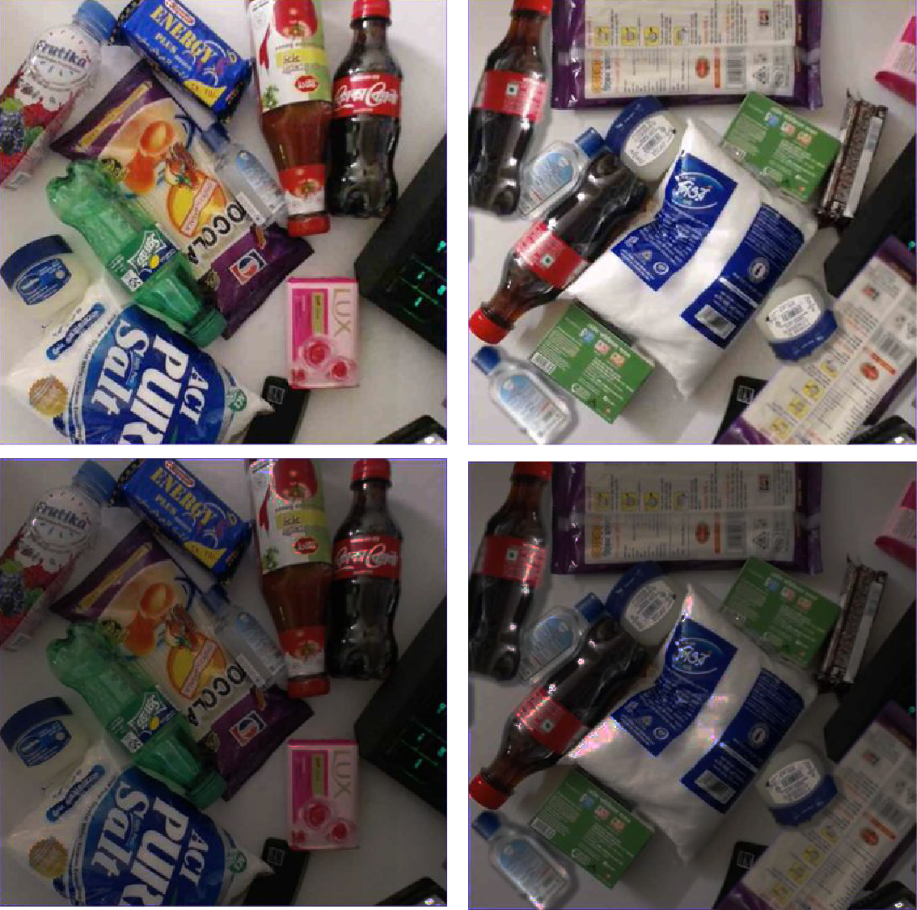
Motivation
DIFFERENT LIGHTING CONDITION AND ORIENTATIONS
TEST SET
PERFORMANCE COMPARISON
FRONT
BACK
LIGHT
DARK
Notes:
V

Slide 9
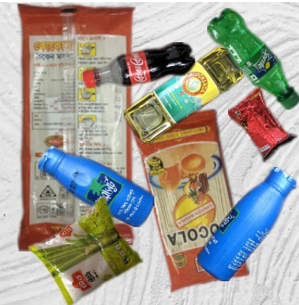
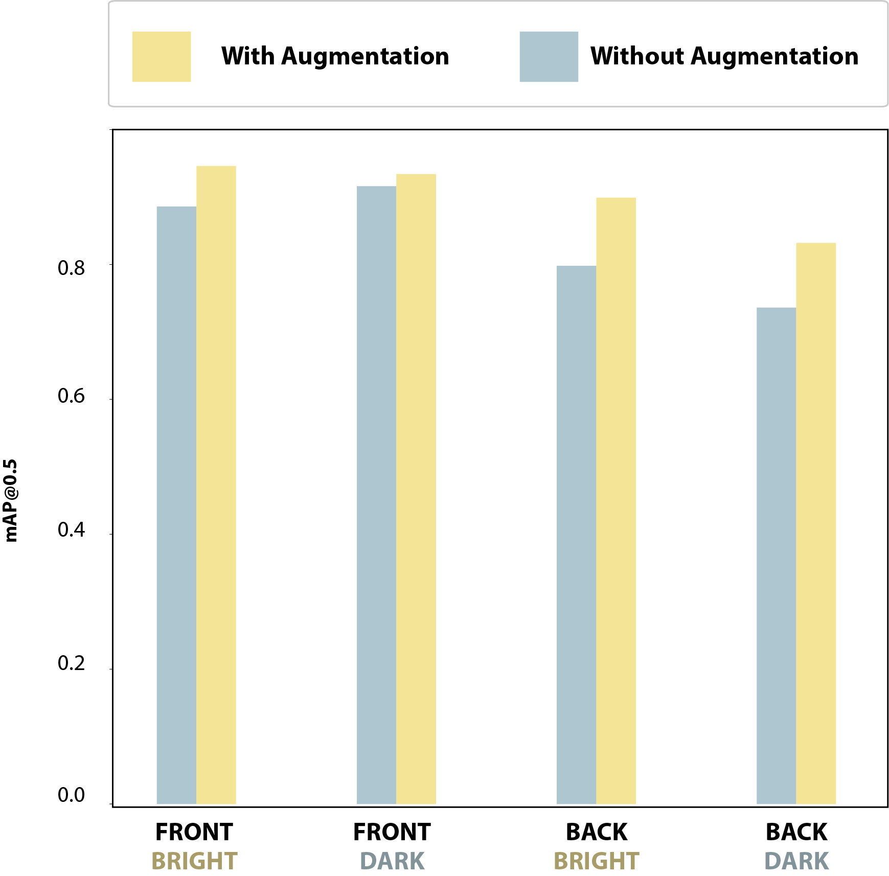
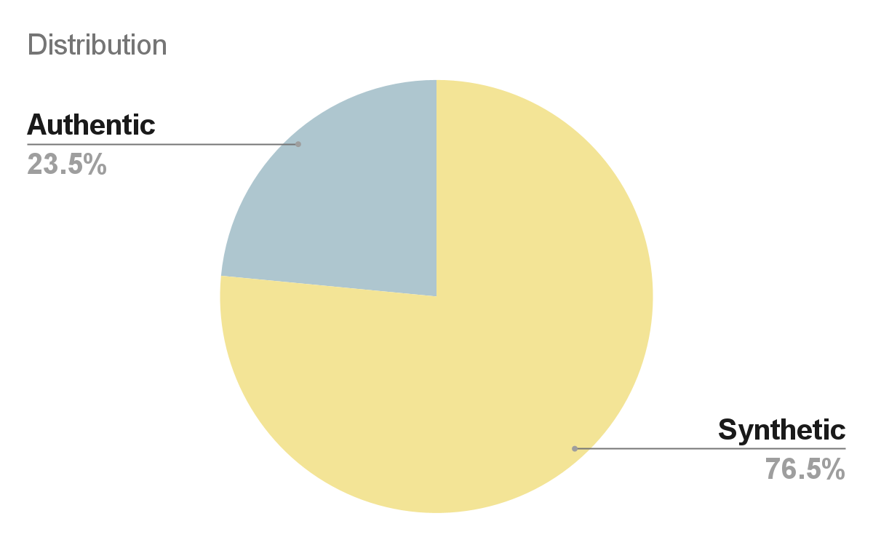
EFFECT OF DATA AUGMENTATION
Distribution of Training
Dataset
Example of Synthetic Photo
Performance Comparison
Notes:
V

Slide 10
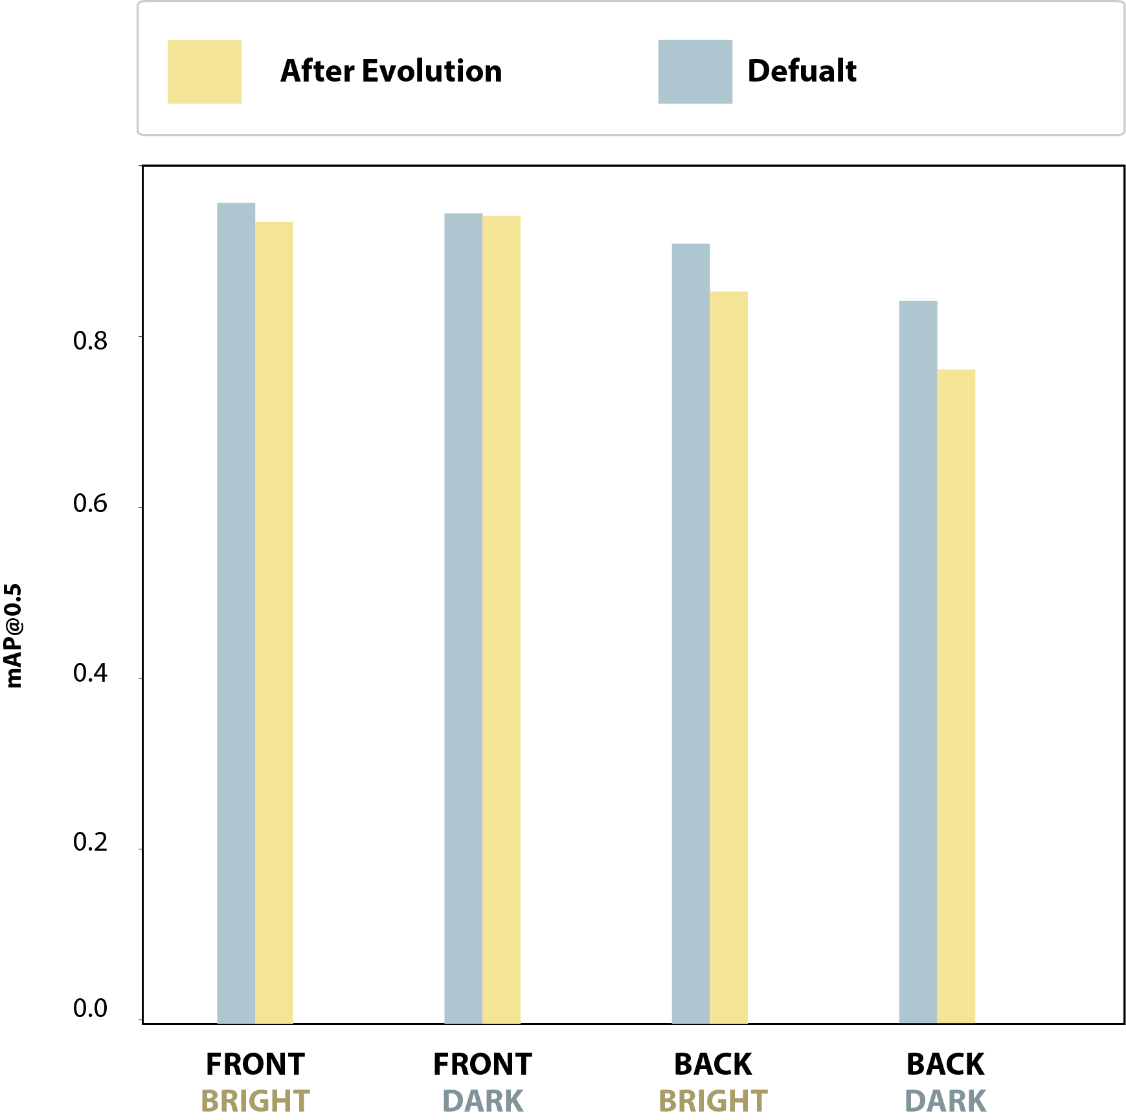
HYPERPARAMETER EVOLUTION
GENETIC ALGORITHM BASED HYPERPARAMETER OPTIMIZATION
Trained 150 Generations
Found Best Hyperparameter on 11th Generation
Notes:
V

Slide 11



Motivation
FUTURE PLANS
Detection for Identical but Different Sized Objects
Billing System for Weight Based Products
Fully Automated Checkout

Slide 12
THANK YOU!

